Slide 1
Laha: A Framework for adaptive optimization of distributed sensor frameworks
Anthony christe
24 February 2020

Slide 2
Distributed sensor networks
Convert physical phenomena into actionable insights
Dynamic
Heterogenous
Explosion of internet connected sensors
Increased bandwidth, storage, and computational requirements
Incomplete or incorrect data
Lots of primitive data, few insights

Slide 3
Laha: addressing DSN issues
Laha is an abstract distributed sensor framework that
Transforms primitive sensor data into actionable insights
Management of sensor data storage, retention, and analysis
Scales with minimal system degradation
Is general enough to apply to multiple DSN domains
Works with heterogenous and dynamic sensors
Provides predictive analytics
Provides self-optimization capabilities

Slide 4
Laha: A Framework for addressing DSN issues
These capabilities were evaluated and tested in the following ways:
Design of two Laha-compatible DSNs
Deployment of two Laha-compatible DSNs
Validation of data collected by deployments
Evaluation of major goals of Laha
Results showing the effectiveness of Laha through the results and evaluation of the Laha-compatible DSNs

Slide 5
Major claims of the laha framework
General and useful framework for multiple DSN domains
Convert primitive sensor data into actionable insights
Tiered management of Big Data
Tertiary goals and claims. Optimization of:
Triggering
Detection/Classification
Predictive analytics
Sensing field topology

Slide 6
Contribution #1: Laha design
Novel abstract distributed sensor framework
Converting primitive data into actionable insights
Sensor data management
Self-optimization capabilities

Slide 7
Contribution #2: Laha Evaluation
Deployment of two Laha-compatible DSNs
Validated data collection
Several experiments that test Laha’s major claims

Slide 8
Contribution #3: Laha-compliant reference implementations
OpenPowerQuality (OPQ)
Distributed power quality (PQ) detection and analysis
Lokahi
Distributed infrasound detection and analysis

Slide 9
Contribution #4: Implications for modern DSNs
A set of implications for modern DSNs through the evaluation of Laha
Confirmation or denial of Laha’s benefits in relation to DSNs
Other domains that Laha is useful or not useful for

Slide 10
Related work

Slide 11

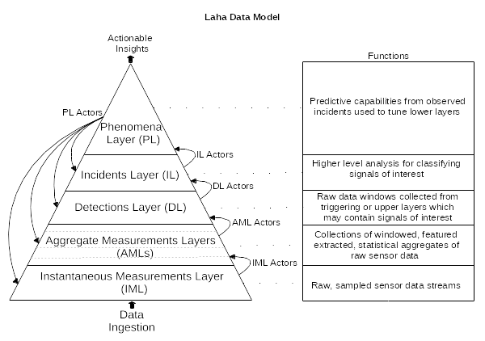
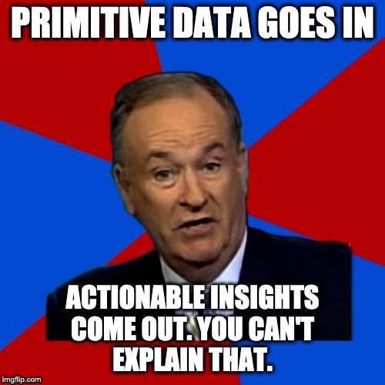
Design: Big data management in Laha
Primitive data into the bottom
Actionable insights out the top
Self-optimization from Phenomena

Slide 12
Design: Phenomena
Phenomena provide
Self-optimization
Actionable insights through
Predictive analytics
Ability to group data
Phenomena
Annotation
Locality
Periodic
Similarity
Future

Slide 13
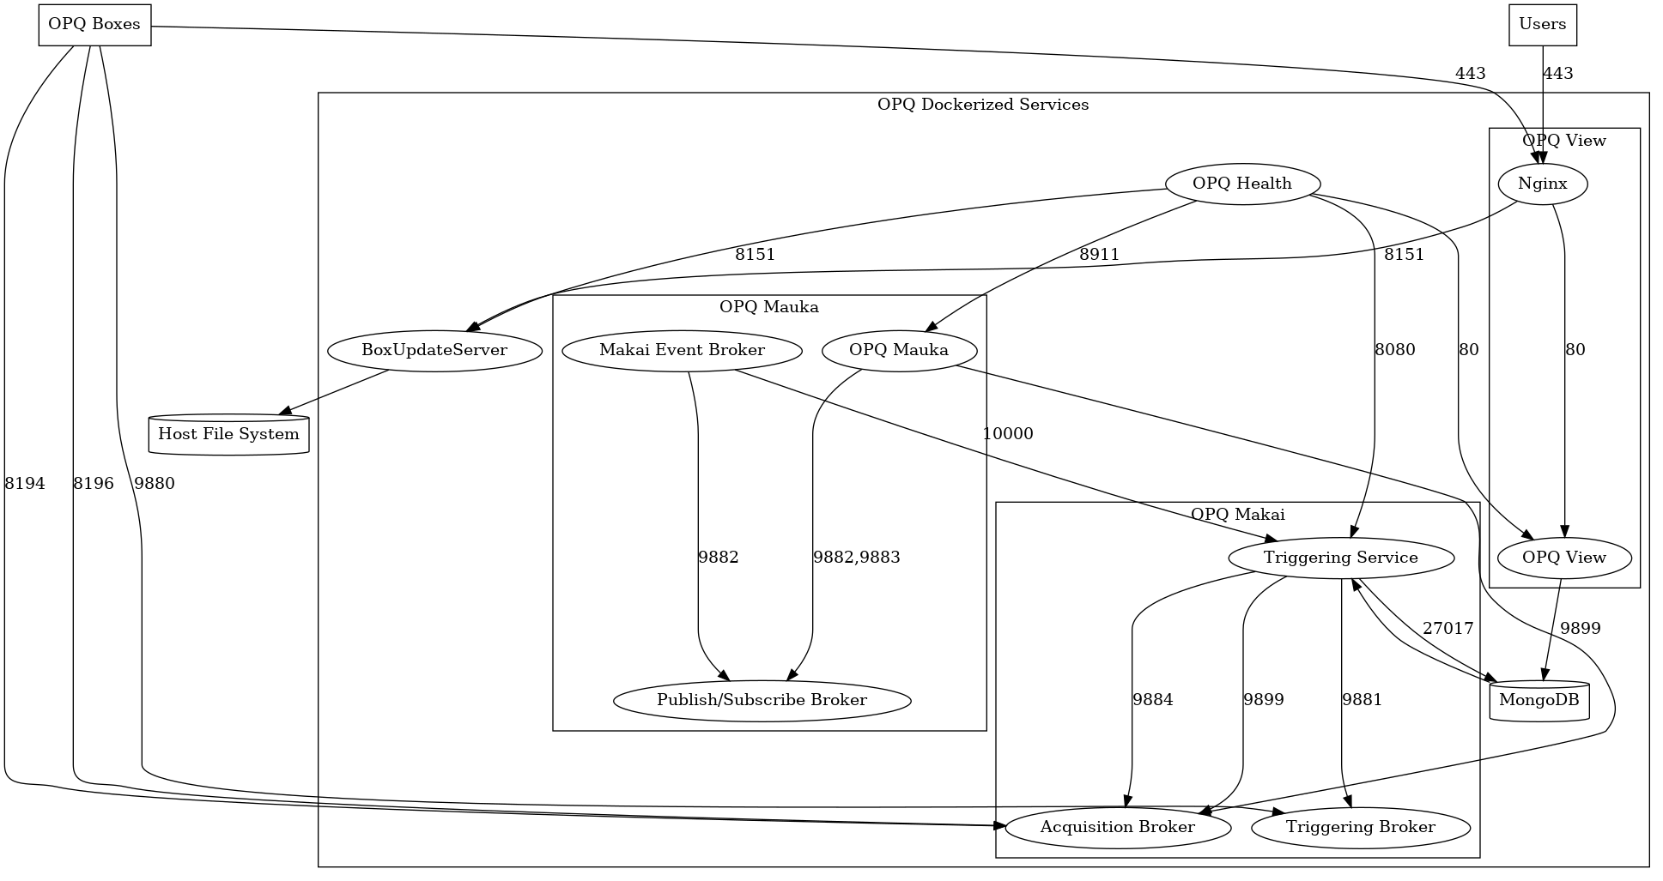
Design of OPQ
OPQ consists of distributed services
Box
Makai/Napali
Mauka
Health
View
MongoDB

Slide 14

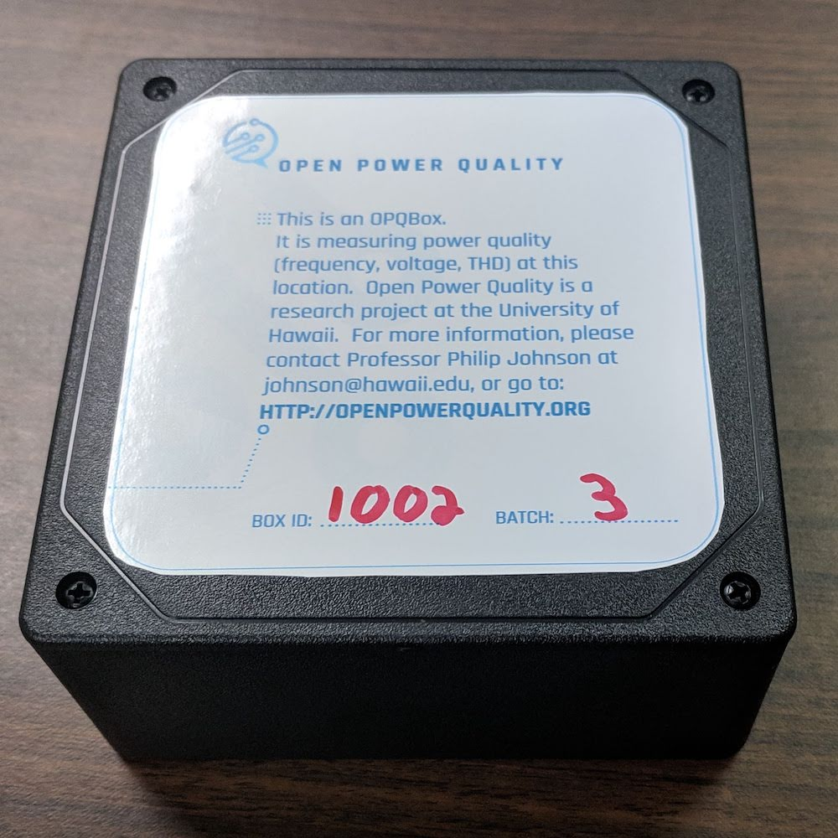
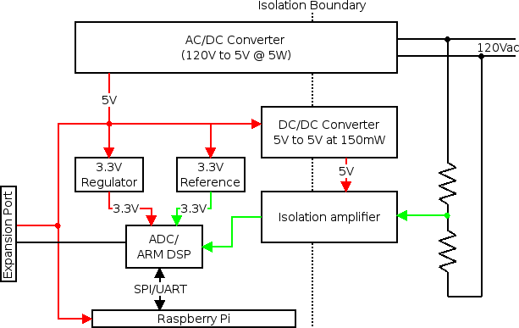
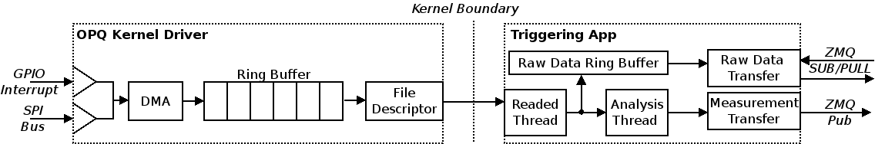
OPQ: Box
Open Source PQ Sensor
12 kHz sampling
Wireless encrypted comms.
Trigger based acquisition
Negrashov 2020

Slide 15
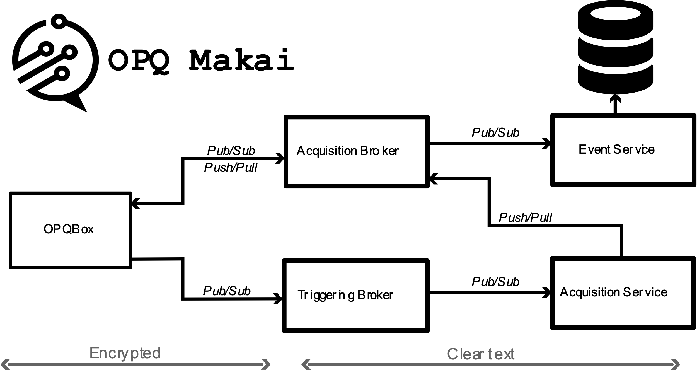
OPQ: Makai/napali
Data acquisition
Triggering
Box communication broker
Negrashov 2020

Slide 16
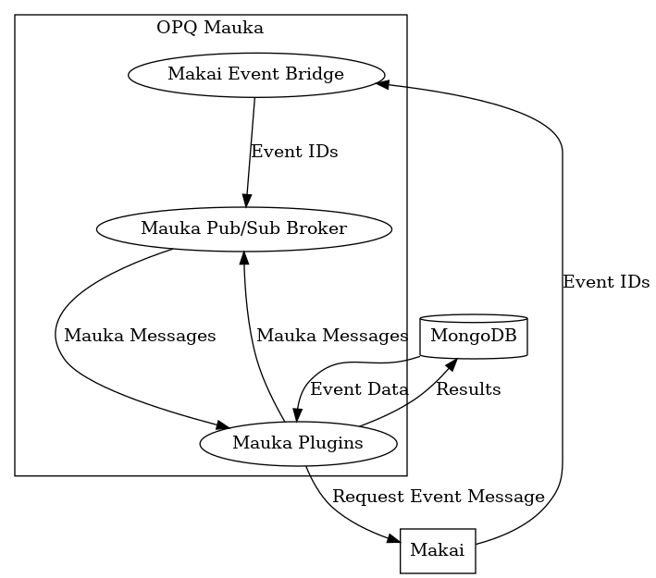
OPQ: mauka
PQ Analysis
Predictive Analytics
Garbage Collection
PQ Plugins (Laha Actors) Providing:
Annotations, base, box optimization, frequency analysis, future phenomena, IEEE1159 voltage analysis, ITIC classification, GC, Makai Event service, mocking capabilities, outage detection periodicity analysis, debugging, Semi-F47 classification, system health/status, metric collection, THD analysis, threshold optimization, transient detection, and triggering

Slide 17
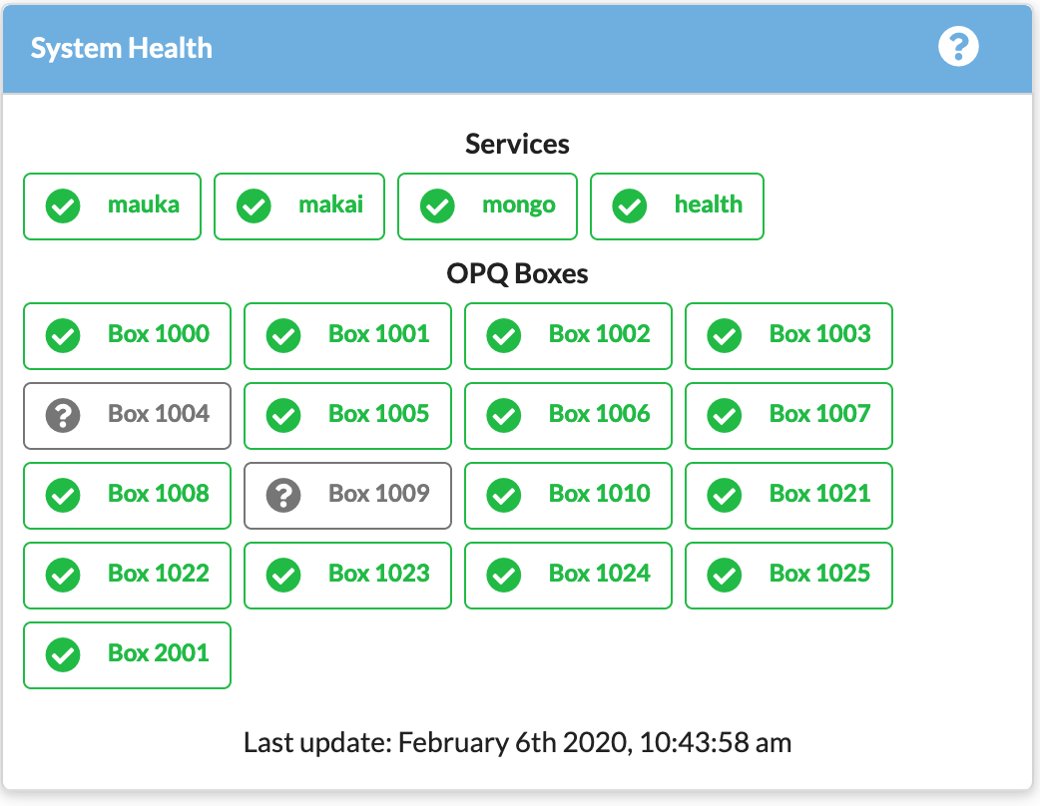
OPQ: Health
Box Monitoring
Service Monitoring
Configurable Alerts

Slide 18
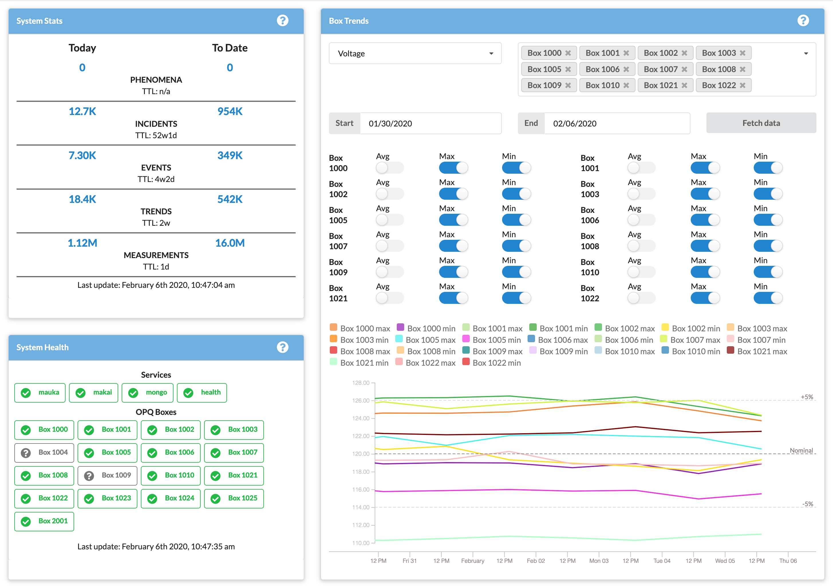
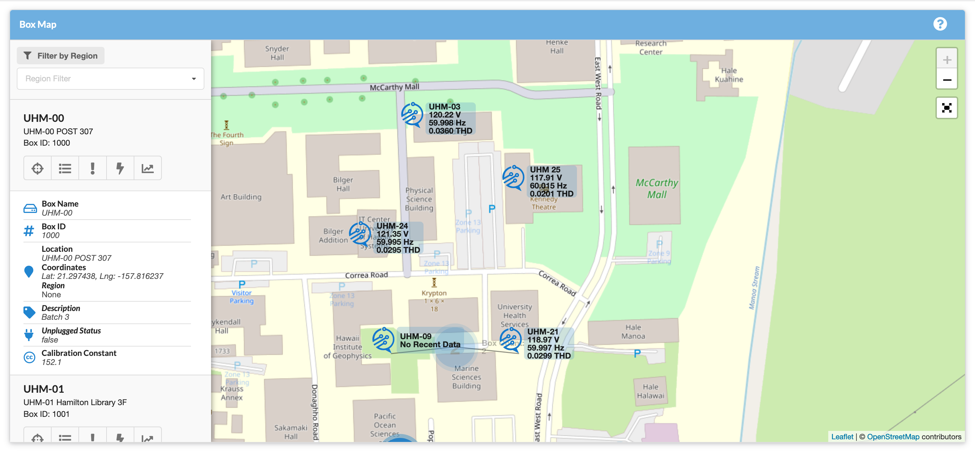
OPQ: view

Slide 19
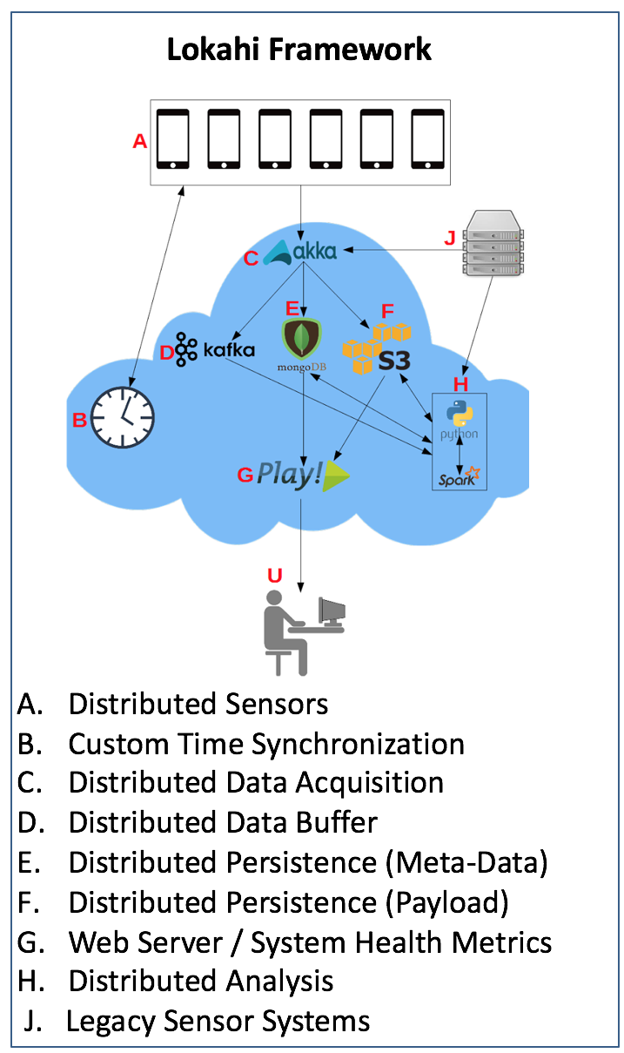
Design of lokahi
Lokahi is made up of several distributed services
Lokahi Sensors
Time Synch Service
Acquisition Service
Web Service
Analysis Service
Collaboration Service

Slide 20
Lokahi: sensors

Slide 21
Lokahi: time synchronization

Slide 22
LOKAHI: Web

Slide 23
Lokahi: Analysis

Slide 24
Lokahi: collaboration

Slide 25
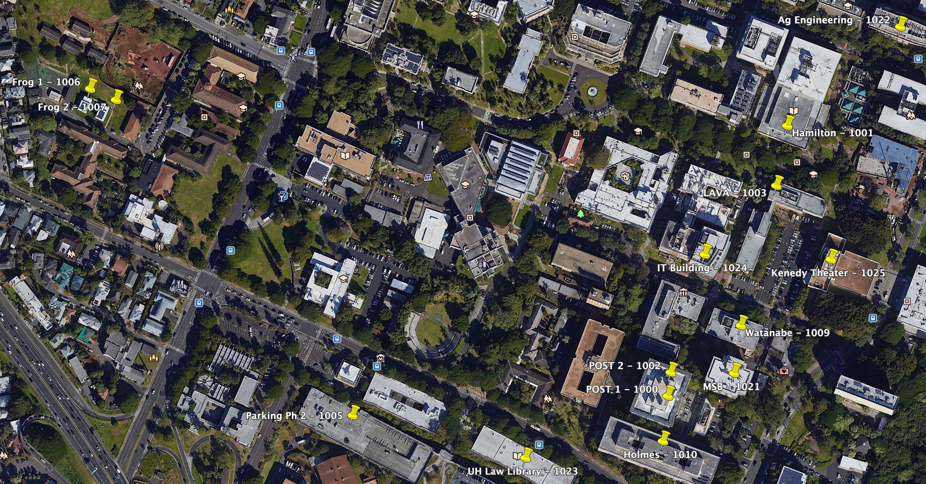
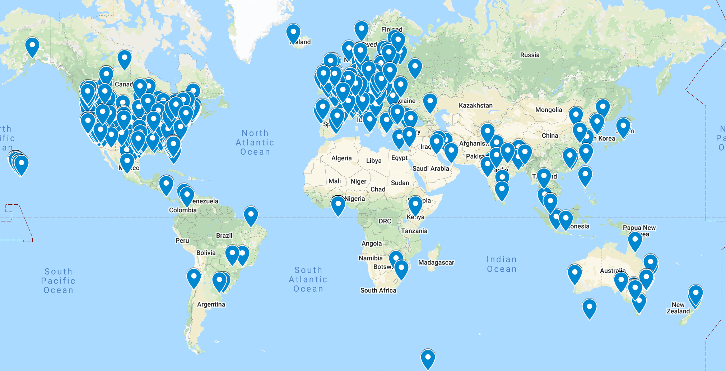
Evaluation: Deployment of laha reference implementations
OPQ UHM Locations
Accessibility
Co-location with UHM sensors
Topology of UHM micro-grid
Lokahi Locations
Ad-hoc public sensor data

Slide 26
Evaluation of data validation
OPQ
Compare against GE PQMII & GE EPM7000
Lokahi
Asmar 2019

Slide 27
Evaluation of generality of laha framework

Slide 28
Evaluation of converting primitive data into actionable insights

Slide 29
Evaluation of big data sensor management

Slide 30
Evaluation of tertiary goals

Slide 31
Results of data validation

Slide 32
Results of generality of laha

Slide 33
Results of converting primitive data into actionable insights

Slide 34
Results of tiered management of big data

Slide 35
Results of tertiary goals

Slide 36
conclusions

Slide 37
Future directions
Machine learning
Modifying windows and thresholds
Additional simulations
Altering the Level-hierarchy
Enhanced metric collection
Expanded sensor coverage

